Slide 1

STATS 432 Computational Statistics
Tutorial 3 – Bootstrapping

Slide 2
Question 1:
Parametric Bootstrapping

Slide 3
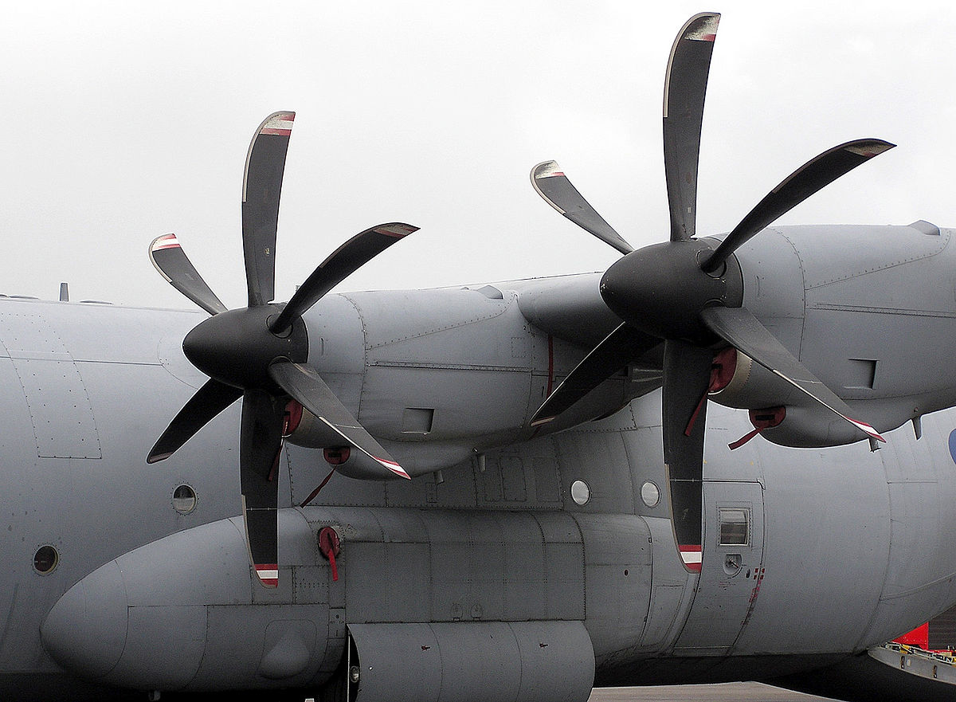

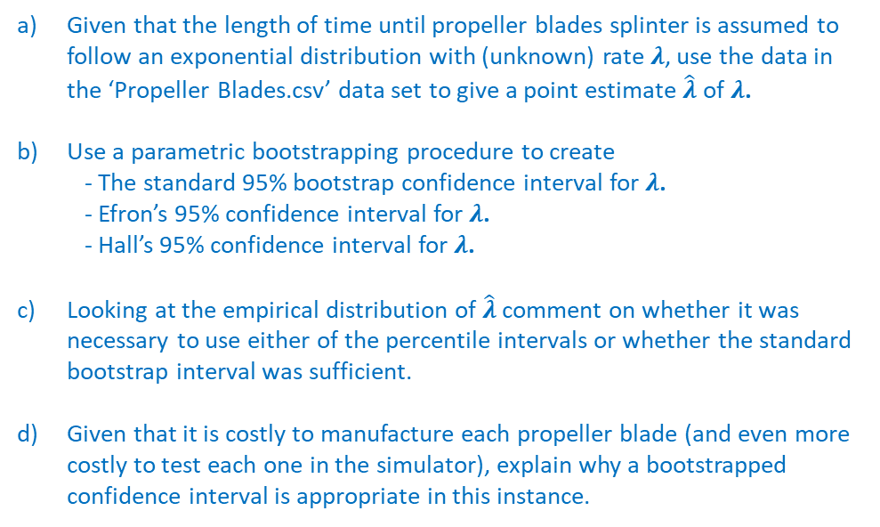
Question 1 : Parametric Bootstrapping
Question 1
The aerospace manufacturer Boeing produces propeller blades for commercial airline engines. Over time propeller blades degrade and splinter with use and must be replaced as part of basic airplane maintenance. As such, Boeing are interested in accurately modelling the length of time until propeller blades splinter. They take a sample of 1,000 propeller blades and test them in a simulator and record the length of time in hours until each one splinters. The data pertaining to this experiment is contained in the CSV data set entitled ‘Propeller Blades.csv’.
Propeller Blades on a Commercial Airplane
Given that the length of time until propeller blades splinter is assumed to follow an exponential distribution with (unknown) rate $λ$, use the data in the ‘Propeller Blades.csv’ data set to give a point estimate $\hat{λ}$ of $λ$.
Use a parametric bootstrapping procedure to create - The standard 95% bootstrap confidence interval for $λ$. - Efron’s 95% confidence interval for $λ$. - Hall’s 95% confidence interval for $λ$.
Looking at the empirical distribution of $\hat{λ}$ comment on whether it was necessary to use either of the percentile intervals or whether the standard bootstrap interval was sufficient.
Given that it is costly to manufacture each propeller blade (and even more costly to test each one in the simulator), explain why a bootstrapped confidence interval is appropriate in this instance.
3
Associated code = Tutorial 3 – Q1

Slide 4

Question 1 : Parametric Bootstrapping
Question 1
Given that the length of time until propeller blades splinter is assumed to follow an exponential distribution with (unknown) rate $λ$, use the data in the ‘Propeller Blades.csv’ data set to give a point estimate $\hat{λ}$ of $λ$.
See Section 1 of the code
If $X \sim exp⁡(λ)$ then $E\left[X\right]=\frac{1}{λ}$ => $λ=\frac{1}{E[X]}$
In the data set provided the average time for a propeller blade to splinter is $\overline{x}=498.4668$ hours
Therefore, our estimate of $λ$ is given by $\hat{λ}= {1 }/{ \overline{x}} ={1 }/{498.4668} =0.002006152$
4
Associated code = Tutorial 3 – Q1

Slide 5

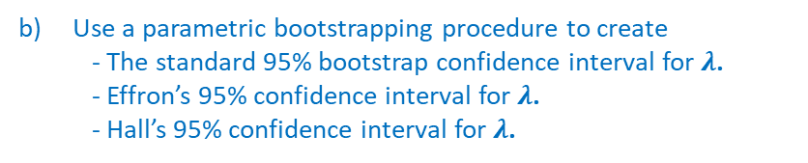
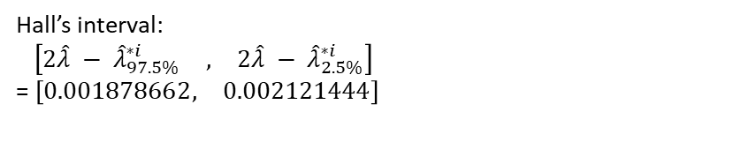
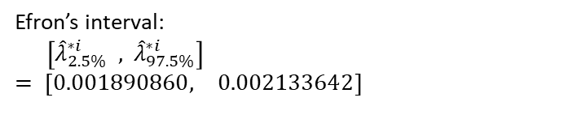
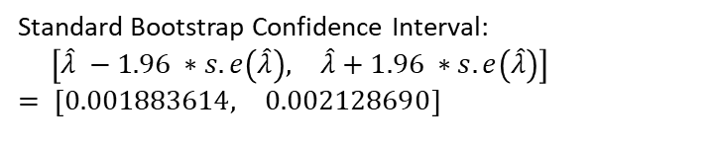
Question 1 : Parametric Bootstrapping
Question 1
Use a parametric bootstrapping procedure to create - The standard 95% bootstrap confidence interval for $λ$. - Effron’s 95% confidence interval for $λ$. - Hall’s 95% confidence interval for $λ$.
# SECTION 2 #
#------------------------------------------------------------------------------------------------------------------#
# Conducting a parametric bootstrapping procedure
# 2.1a - Conducting the bootstrapping procedure
# Define the number of bootstrap samples
> L <- 5000
# Define a vector called 'boot.lambda' of length B
> boot.lambda <- rep(NA,L)
# Set seed to ensure we obtain the same bootstrap samples each time code is run
> set.seed(12345)
# For i=1,...,L do
> for (i in 1:L) {
# Obtain n observations from the exp(\hat{\lambda}) distribution
> pseudo.data <- rexp(n, rate=hat_lambda)
# Calculate \lambda^{*i} for the bootstrap sample
> this.lambda <- 1 / mean(pseudo.data)
# Append to the 'boot.lambda' vector
> boot.lambda[i] <- this.lambda }
# 3.1a - Calculating the standard error of \hat{\lambda}
> se.lambda <- sd(boot.lambda)
# 3.1b - Constructing the standard confidence interval for lambda
> lambda.std.CI <- c(hat_lambda - 1.96 * se.lambda, hat_lambda + 1.96 * se.lambda)
# 3.1c - Obtain percentiles of the values boot.lambda vector
> Efron <- quantile(boot.lambda, probs = c(0.025, 0.975)) > Hall <- c( 2*hat_lambda - quantile(boot.lambda, probs = c(0.975)), 2*hat_lambda - quantile(boot.lambda, probs = c(0.025)))
See Section 2 & 3 of the code
$$\hat{λ}= 0.002006152$$
Standard error of $\hat{λ}=6.25193e−05$
Standard Bootstrap Confidence Interval:
$\left[\begin{matrix}\hat{λ} −1.96 ∗s.e\left(\hat{λ}\right), & \hat{λ}+1.96 ∗s.e\left(\hat{λ}\right)\end{matrix}\right]$
$$= \left[\begin{matrix}0.001883614, & 0.002128690\end{matrix}\right]$$
Efron’s interval:
$\left[{\hat{λ}}_{2.5\%}^{∗i} , { \hat{λ}}_{97.5\%}^{∗i}\right]$
$$= \left[\begin{matrix}0.001890860, & 0.002133642\end{matrix}\right]$$
Hall’s interval:
$\left[\begin{matrix}2\hat{λ} −{ \hat{λ}}_{97.5\%}^{∗i} & , & 2\hat{λ} −{ \hat{λ}}_{2.5\%}^{∗i}\end{matrix}\right]$
= $\left[\begin{matrix}0.001878662, & 0.002121444\end{matrix}\right]$
5
Associated code = Tutorial 3 – Q1

Slide 6
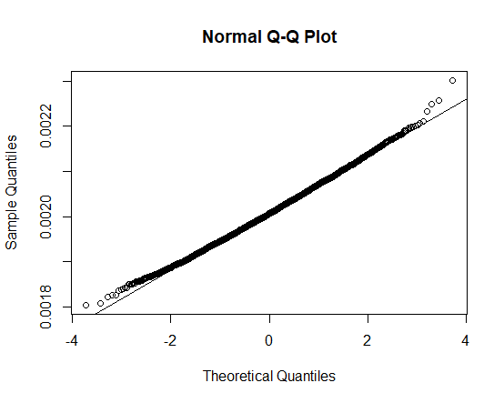
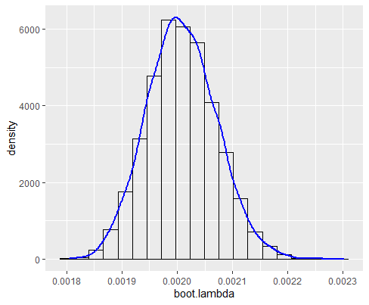
Question 1 : Parametric Bootstrapping
Question 1
Looking at the empirical distribution of $\hat{λ}$, comment on whether it was necessary to use either of the percentile intervals or whether the standard bootstrap interval was sufficient.
See Section 3 of the code
It was not necessary to produce the percentile confidence intervals. The standard 95% bootstrap confidence interval would have sufficed. The histograms of the bootstrapped $λ^{∗(i)}$ values look to be approximately normally distributed. This is re-enforced by the associated QQ-plot which do not suggest any departures from normality.
6
Associated code = Tutorial 3 – Q1

Slide 7
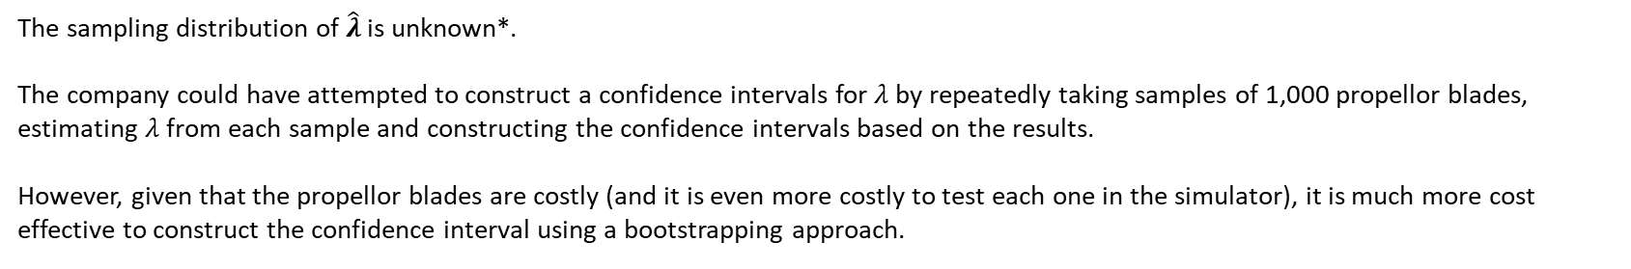
Question 1 : Parametric Bootstrapping
Question 1
Given that it is costly to manufacture each propeller blade (and even more costly to test each one in the simulator), explain why a bootstrapped confidence interval is appropriate in this instance.
The sampling distribution of $\hat{λ}$ is unknown*.
The company could have attempted to construct a confidence intervals for $λ$by repeatedly taking samples of 1,000 propellor blades, estimating $λ$ from each sample and constructing the confidence intervals based on the results.
However, given that the propellor blades are costly (and it is even more costly to test each one in the simulator), it is much more cost effective to construct the confidence interval using a bootstrapping approach.
7
Associated code = Tutorial 3 – Q1
* We will assume its unknown for the purposes of this example.

Slide 8
Question 2:
Non-Parametric Bootstrapping
Example 7.4.2 in the course notes

Slide 9
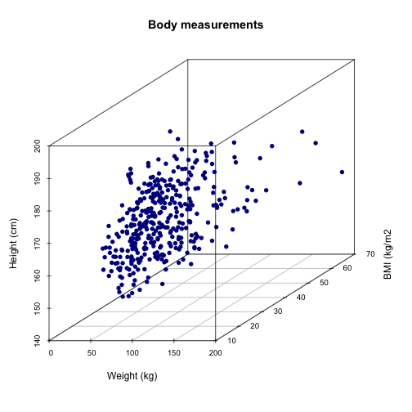
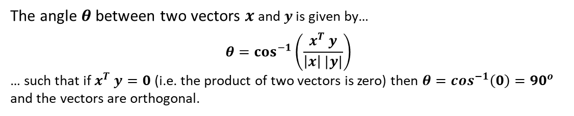

What Do We Need from a Set of Axes?
Question 2
In order to represent the location of a point in n-dimensional space we need a set of axes.
Typically, we use the standard coordinate system for $ℝ^{n}$, i.e. we use the following vectors for our axes
$$Γ = \left\{\begin{matrix} \left(\begin{matrix}1 \\ 0 \\ \begin{matrix}⋮ \\ 0\end{matrix}\end{matrix}\right) & \left(\begin{matrix}0 \\ 1 \\ \begin{matrix}⋮ \\ 0\end{matrix}\end{matrix}\right) & \begin{matrix}\begin{matrix}… \\ … \\ \begin{matrix}⋱ \\ …\end{matrix}\end{matrix} & \left(\begin{matrix}0 \\ 0 \\ \begin{matrix}⋮ \\ 1\end{matrix}\end{matrix}\right)\end{matrix}\end{matrix} \right\}$$
Illustration of Plotting Data in 3-Dimensions
However, this is not the only set of axes vectors we could use.
All we require from a set of axes vectors is that
All vectors are orthogonal
All vectors have length one
If these two conditions are satisfied we say the axis vectors are orthonormal
The angle $θ$ between two vectors $x$ and $y$ is given by…
$$θ=\cos^{−1}\left(\frac{x^{T} y}{\left|x\right| |y|}\right)$$
… such that if $x^{T} y=0$ (i.e. the product of two vectors is zero) then $θ=\cos^{−1}\left(0\right)={90}^{o}$ and the vectors are orthogonal.
It is easy to show that the vectors in the standard coordinate system $Γ$ are orthonormal.
9

Slide 10
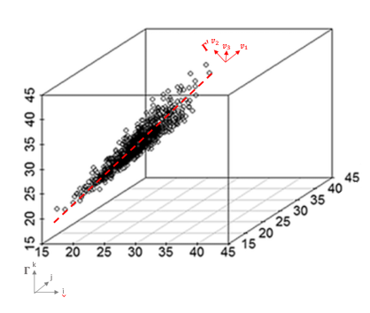
The Idea of Principal Component Analysis
Question 2
Suppose that we have some n-dimensional data. The basic idea behind principal component analysis is as follows…
Instead of representing the data in the standard coordinate system $Γ$
why not represent it in the coordinate system that ‘best fits’ the data $Γ′$ ?
Illustration of Representing 3-Dimensional Data is the Coordinate System that Best Fits the data
10

Slide 11
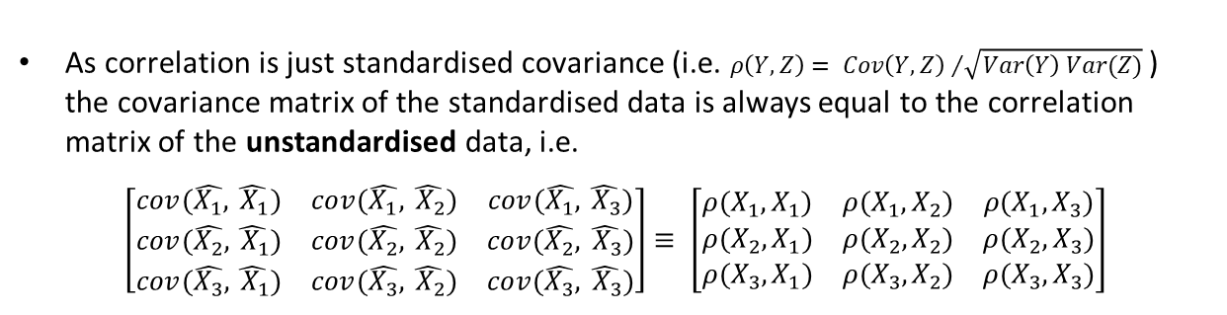
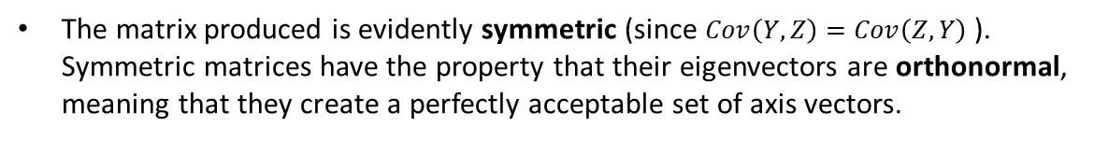

Principal Component Analysis Process
Question 2
Typically the PCA process begins by normalising / standardising the data to have mean zero $(μ=0)$ and variance one $\left(σ^{2}=1\right).$ This is done to account for the fact that each of the variables may have different scales.
Illustration of Representing 3-Dimensional Data is the Coordinate System that Best Fits the data
The covariance matrix of the standardised data is then formed
$$\left[\begin{matrix}cov(\hat{X_{1}},\hat{ X_{1}}) & cov(\hat{X_{1}},\hat{ X_{2}}) & cov(\hat{X_{1}},\hat{ X_{3}}) \\ cov(\hat{X_{2}},\hat{ X_{1}}) & cov(\hat{X_{2}},\hat{ X_{2}}) & cov(\hat{X_{2}},\hat{ X_{3}}) \\ cov(\hat{X_{3}},\hat{ X_{1}}) & cov(\hat{X_{3}},\hat{ X_{2}}) & cov(\hat{X_{3}},\hat{ X_{3}})\end{matrix}\right]$$
As correlation is just standardised covariance (i.e. $ρ\left(Y,Z\right)= {Cov\left(Y,Z\right) }/{\sqrt{Var\left(Y\right) Var(Z)}}$ ) the covariance matrix of the standardised data is always equal to the correlation matrix of the unstandardised data, i.e.
$$\left[\begin{matrix}cov(\hat{X_{1}},\hat{ X_{1}}) & cov(\hat{X_{1}},\hat{ X_{2}}) & cov(\hat{X_{1}},\hat{ X_{3}}) \\ cov(\hat{X_{2}},\hat{ X_{1}}) & cov(\hat{X_{2}},\hat{ X_{2}}) & cov(\hat{X_{2}},\hat{ X_{3}}) \\ cov(\hat{X_{3}},\hat{ X_{1}}) & cov(\hat{X_{3}},\hat{ X_{2}}) & cov(\hat{X_{3}},\hat{ X_{3}})\end{matrix}\right]≡ \left[\begin{matrix}ρ(X_{1},X_{1}) & ρ(X_{1},X_{2}) & ρ(X_{1},X_{3}) \\ ρ(X_{2},X_{1}) & ρ(X_{2},X_{2}) & ρ(X_{2},X_{3}) \\ ρ(X_{3},X_{1}) & ρ(X_{3},X_{2}) & ρ(X_{3},X_{3})\end{matrix}\right]$$
The matrix produced is evidently symmetric (since $Cov\left(Y,Z\right)=Cov\left(Z,Y\right)$ ). Symmetric matrices have the property that their eigenvectors are orthonormal, meaning that they create a perfectly acceptable set of axis vectors.
11

Slide 12
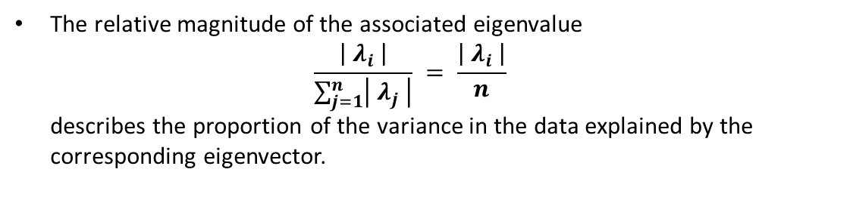
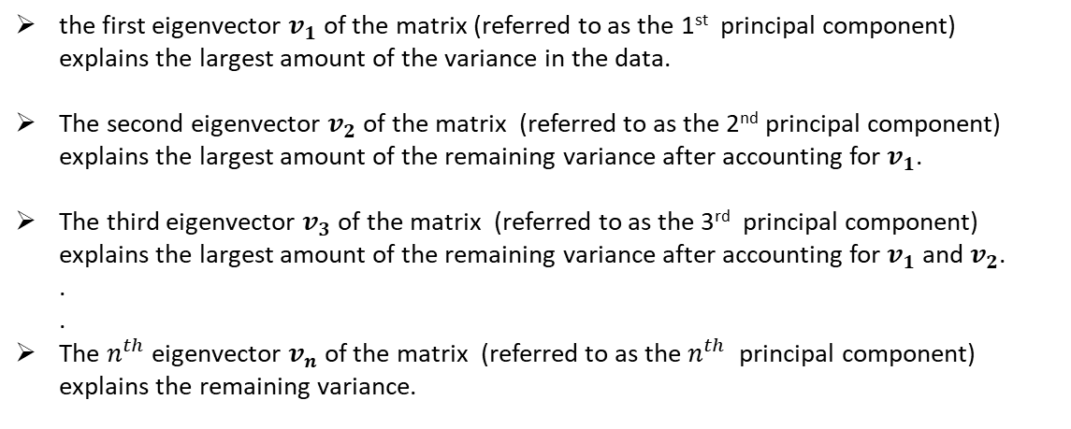
Principal Component Analysis Process
Question 2
When you arrange the eigenvectors of the covariance / correlation matrix in descending order of the corresponding eigenvalues…
the first eigenvector $v_{1}$ of the matrix (referred to as the 1st principal component) explains the largest amount of the variance in the data.
The second eigenvector $v_{2}$ of the matrix (referred to as the 2nd principal component) explains the largest amount of the remaining variance after accounting for $v_{1}$.
The third eigenvector $v_{3}$ of the matrix (referred to as the 3rd principal component) explains the largest amount of the remaining variance after accounting for $v_{1}$ and $v_{2}$. . .
The $n^{th}$ eigenvector $v_{n}$ of the matrix (referred to as the $n^{th}$ principal component) explains the remaining variance.
Illustration of Representing 3-Dimensional Data is the Coordinate System that Best Fits the data
The relative magnitude of the associated eigenvalue $\frac{\left| λ_{i} \right|}{\sum_{j=1}^{n}{\left| λ_{j} \right|}} = \frac{\left| λ_{i} \right|}{n}$ describes the proportion of the variance in the data explained by the corresponding eigenvector.
12

Slide 13
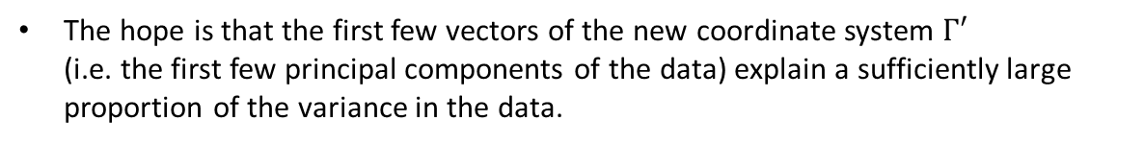
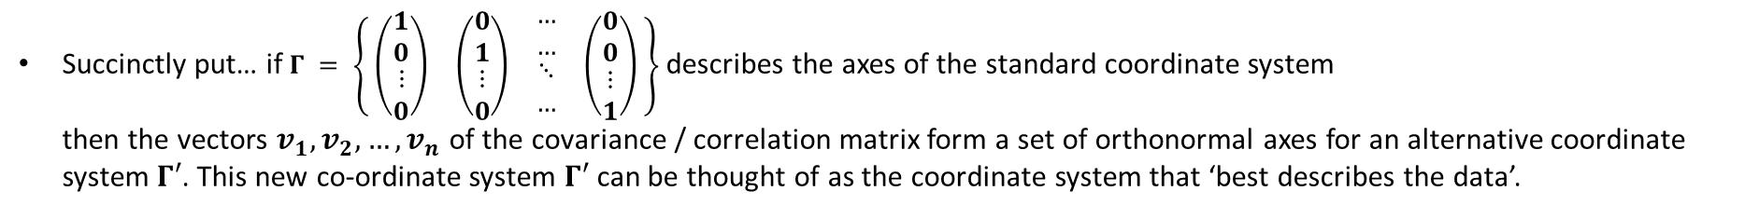
Principal Component Analysis Process
Question 2
Succinctly put… if $Γ = \left\{\begin{matrix} \left(\begin{matrix}1 \\ 0 \\ \begin{matrix}⋮ \\ 0\end{matrix}\end{matrix}\right) & \left(\begin{matrix}0 \\ 1 \\ \begin{matrix}⋮ \\ 0\end{matrix}\end{matrix}\right) & \begin{matrix}\begin{matrix}… \\ … \\ \begin{matrix}⋱ \\ …\end{matrix}\end{matrix} & \left(\begin{matrix}0 \\ 0 \\ \begin{matrix}⋮ \\ 1\end{matrix}\end{matrix}\right)\end{matrix}\end{matrix} \right\}$ describes the axes of the standard coordinate system then the vectors $v_{1}, v_{2}, …, v_{n}$ of the covariance / correlation matrix form a set of orthonormal axes for an alternative coordinate system $Γ′$. This new co-ordinate system $Γ′$can be thought of as the coordinate system that ‘best describes the data’.
Illustration of Representing 3-Dimensional Data is the Coordinate System that Best Fits the data
The hope is that the first few vectors of the new coordinate system $Γ′$ (i.e. the first few principal components of the data) explain a sufficiently large proportion of the variance in the data.
If so, we may throw away the other dimensions of the data and reduce the amount of data we have to hold.
In this sense, principal component analysis can be thought of as a dimensionality reduction technique. It is very useful in telecommunication systems (e.g. Zoom).
Under certain circumstances, (i.e. the first principal component explaining the vast majority of the variance in the data) it can also be used to condense n-dimensional data into a 1-dimensional score (see Assignment 3).
13

Slide 14
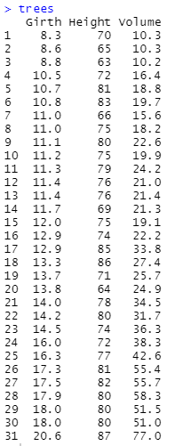
Question 2: Non-Parametric Bootstrapping
Question 2
The ‘trees’ data set
The data set ‘trees’ is stored by default in R’s memory. Read the data into a current R session and inspect the data. Set the number of rows as a variable named n. Set the number of columns as a variable named p.
Standardise the data and obtain the covariance matrix of the standardised data.
Obtain the correlation matrix of the unstandardised data. Show that this matrix is identical to the matrix produced in part b).
Obtain the eigenvectors of the matrix. Show that they are orthonormal and hence form a perfectly acceptable set of axis vectors.
Obtain the eigenvalues of the matrix. Calculate the proportion of the variance explained by the first, second and third principal components.
Conduct a non-parametric bootstrapping procedure to create a standard 95% bootstrap confidence interval for the proportion of the variance explained by the first principal component.
If, after conducting principal component analysis, we were to throw away the data held in the second and third principal components, we would reduce the size of the data set by a factor of 2/3. Roughly what proportion of the information would we lose in doing so?
14
Associated code = Tutorial 3 – Q2

Slide 15
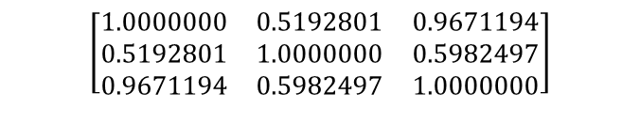
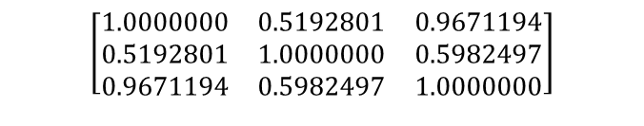
Question 2: Non-Parametric Bootstrapping
Question 2
The ‘trees’ data set
The data set ‘trees’ is stored by default in R’s memory. Read the data into a current R session and inspect the data. Set the number of rows as a variable named n. Set the number of columns as a variable named p.
See Section 1.1a & 1.1b of the code
# 1.1a - Read in data trees which is stored in R's memory by default trees
str(trees)
# 1.1b - Set the number of rows and columns in the data set as variables
n <- nrow(trees)
p <- ncol(trees)
Standardise the data and obtain the covariance matrix of the standardised data.
See Section 1.1c of the code
# 1.1c - Standardize the variables, then obtain the covariance matrix
std_trees <- trees
std_trees[1 : 3] <- as.data.frame(scale(std_trees[1 : 3]))
cov(std_trees)
$$\left[\begin{matrix}1.0000000 & 0.5192801 & 0.9671194 \\ 0.5192801 & 1.0000000 & 0.5982497 \\ 0.9671194 & 0.5982497 & 1.0000000\end{matrix}\right]$$
Obtain the correlation matrix of the unstandardised data. Show that this is identical to the matrix produced in part b).
See Section 1.1d of the code
$$\left[\begin{matrix}1.0000000 & 0.5192801 & 0.9671194 \\ 0.5192801 & 1.0000000 & 0.5982497 \\ 0.9671194 & 0.5982497 & 1.0000000\end{matrix}\right]$$
# 1.1d - Obtain correlation matrix of the non-standardised data
data.corr <- cor(trees)
data.corr
15
Associated code = Tutorial 3 – Q2

Slide 16
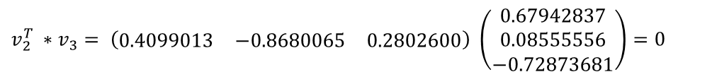

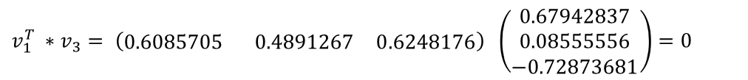

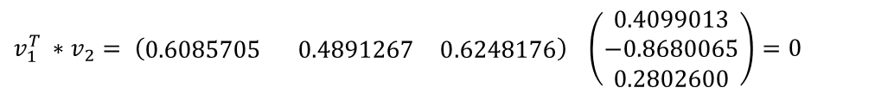

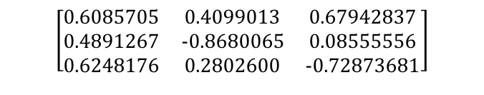
Question 2: Non-Parametric Bootstrapping
Question 2
The ‘trees’ data set
Obtain the eigenvectors of the matrix. Show that they are orthonormal and hence form a perfectly acceptable set of axis vectors.
See Section 1.1e of the code
# 1.1e - Obtain eigenvalues and eigenvectors of correlation matrix
data.eigen <- eigen(data.corr)
# Obtain eigenvectors of the correlation matrix / covariance matrix of standardized data
eigen(data.corr)$vectors
$$v_{1}$$
$$v_{2}$$
$$v_{3}$$
$$\left[\begin{matrix}0.6085705 & 0.4099013 & 0.67942837 \\ 0.4891267 & −0.8680065 & 0.08555556 \\ 0.6248176 & 0.2802600 & −0.72873681\end{matrix}\right]$$
$${\left|v_{1}\right|}^{2} ={0.6085705}^{2} +{0.4891267}^{2} + {0.6248176}^{2} =1$$
$${\left|v_{2}\right|}^{2} ={0.4099013}^{2} +{0.8680065}^{2} + {0.2802600}^{2} =1$$
Vectors all have length 1
$${\left|v_{3}\right|}^{2} ={0.67942837}^{2} +{0.08555556}^{2} + {0.72873681}^{2} =1$$
$$v_{1}^{T} ∗v_{2}= \left(\begin{matrix}0.6085705 & 0.4891267 & 0.6248176\end{matrix}\right) \left(\begin{matrix}0.4099013 \\ −0.8680065 \\ 0.2802600\end{matrix}\right)=0$$
$$v_{1}^{T} ∗v_{3}= \left(\begin{matrix}0.6085705 & 0.4891267 & 0.6248176\end{matrix}\right) \left(\begin{matrix}0.67942837 \\ 0.08555556 \\ −0.72873681\end{matrix}\right)=0$$
All vectors are orthogonal
$$v_{2}^{T} ∗v_{3}= \left(\begin{matrix}0.4099013 & −0.8680065 & 0.2802600\end{matrix}\right) \left(\begin{matrix}0.67942837 \\ 0.08555556 \\ −0.72873681\end{matrix}\right)=0$$
16
Associated code = Tutorial 3 – Q2

Slide 17


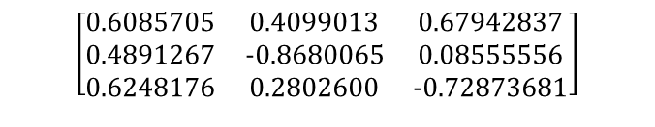
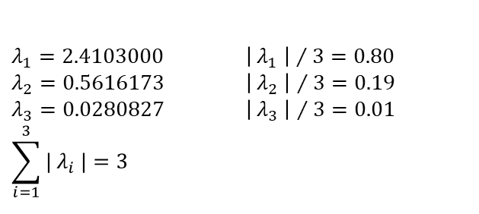
Question 2: Non-Parametric Bootstrapping
Question 2
The ‘trees’ data set
Obtain the eigenvalues of the matrix. Calculate the proportion of the variance explained by the first, second and third principal components.
See Section 1.1e of the code
# 1.1e - Obtain eigenvalues and eigenvectors of correlation matrix
data.eigen <- eigen(data.corr)
# Obtain eigenvectors of the correlation matrix / covariance matrix of standardized data
eigen(data.corr)$vectors
# Obtain eigenvalues of the correlation matrix / covariance matrix of standardized data
eigen(data.corr)$values
# obtain proportions of variance explained by each eigenvector
data.percent <- 100*data.eigen$values/sum(data.eigen$values)
data.percent
$$v_{1}$$
$$v_{2}$$
$$v_{3}$$
$$\left[\begin{matrix}0.6085705 & 0.4099013 & 0.67942837 \\ 0.4891267 & −0.8680065 & 0.08555556 \\ 0.6248176 & 0.2802600 & −0.72873681\end{matrix}\right]$$
$λ_{1}=2.4103000$ ${\left| λ_{1} \right| }/{ 3}=0.80$
$λ_{2}=0.5616173$ ${\left| λ_{2} \right| }/{ 3}=0.19$
$λ_{3}=0.0280827$ ${\left| λ_{3} \right| }/{ 3}=0.01$
$$\sum_{i=1}^{3}{| λ_{i} |}=3$$
The 1st principal component explains 80% of the variance in the data.
The 2nd principal component explains 19% of the variance in the data.
The 3rd principal component explains 1% of the variance in the data.
17
Associated code = Tutorial 3 – Q2

Slide 18
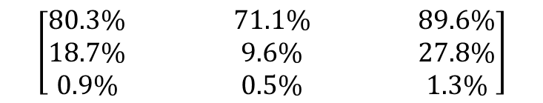
Question 2: Non-Parametric Bootstrapping
Question 2
The ‘trees’ data set
Conduct a non-parametric bootstrapping procedure to create a standard 95% bootstrap confidence interval for the proportion of the variance explained by the first principal component.
See Section 2 & 3 of the code
Estimated
Lower CI Limit
Upper CI Limit
PC1
$$\left[\begin{matrix}80.3\% & 71.1\% & 89.6\% \\ 18.7\% & 9.6\% & 27.8\% \\ 0.9\% & 0.5\% & 1.3\%\end{matrix}\right]$$
PC2
PC3
If, after conducting principal component analysis, we were to throw away the data held in the second and third principal components, we would reduce the size of the data set by a factor of 2/3. Roughly what proportion of the information would we lose in doing so?
For this particular sample, if we were to discard the data held in the 2nd and 3rd principal components, we would reduce the size of the data set by a factor of 2/3 at the expense of loosing 19.7% (1-0.803) of the data.
If repeating this process on other samples of trees, we would expect to lose somewhere between 28.9% (1-0.711) and 10.4% (1-0.896) of the data.
18
Associated code = Tutorial 3 – Q2

